Slide 1
Is the Pen Mightier than the Sword? Op-Ed Use by Retired Military Officers in America’s Major Newspapers
Pete Erickson
University of Wisconsin-Madison
PS 904: Prof. Ellie Powell
April 27, 2020

Slide 2
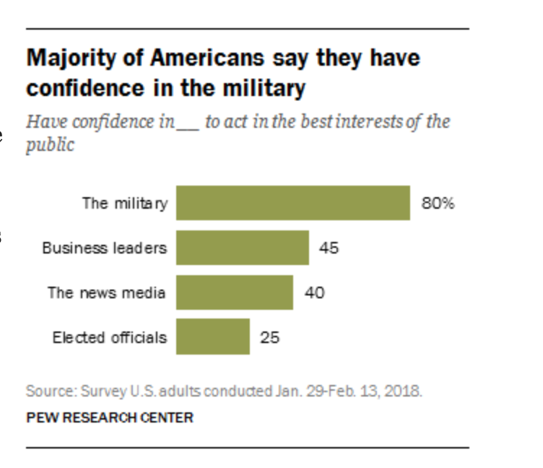
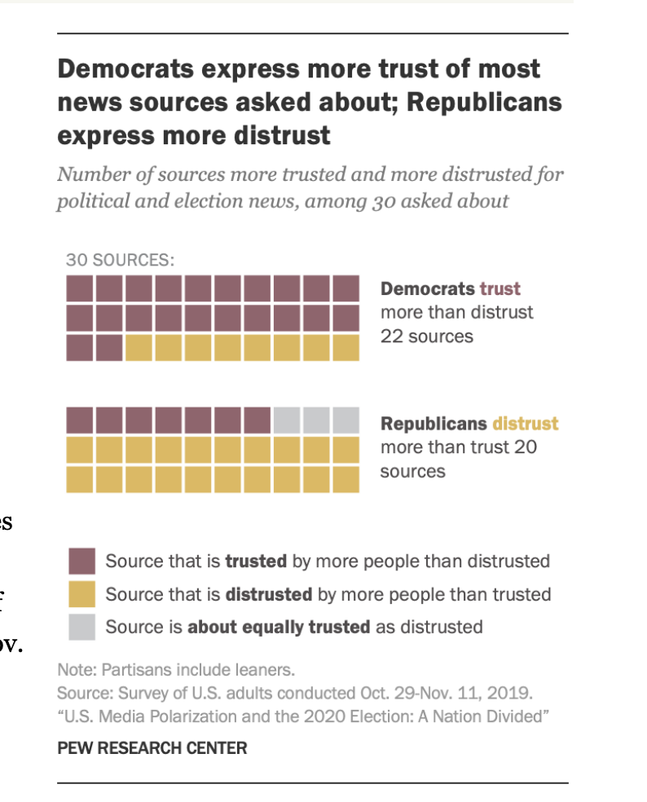
Research Question
In what ways are Retired Military Officers Attempting to Influence Public Opinion in the USA?
This is an empirical and normative question
Why This Question Matters:
The Military is the most-trusted Institution in America (Pew Research Survey, February 2018)
The Public can reasonably expect that the expertise of retired military officers be used to weigh in on issues that pertain to a certain bundle of issues (national security, military matters, etc.)
We know that the media itself is trusted along highly partisan lines (Pew Research Survey, November 2019)
The “norm” for retired military officers is to stay apolitical unless one is running for office. We have seen this norm strained in the past, however.

Slide 3
The Call for a Professional Ethic
“Yours is the profession of arms, the will to win, the sure knowledge that in war there is no substitute for victory, that if you lose, the Nation will be destroyed, that the very obsession of your public service must be Duty, Honor, Country.
Others will debate the controversial issues, national and international, which divide men’s minds. But serene, calm, aloof, you stand as the Nation’s war guardians, as its lifeguards from the raging tides of international conflict, as its gladiators in the arena of battle. For a century and a half you have defended, guarded and protected its hallowed traditions of liberty and freedom, of right and justice.
Let civilian voices argue the merits or demerits of our processes of government. Whether our strength is being sapped by deficit financing indulged in too long, by federal paternalism grown too mighty, by power groups grown too arrogant, by politics grown too corrupt, by crime grown too rampant, by morals grown too low, by taxes grown too high, by extremists grown too violent; whether our personal liberties are as firm and complete as they should be.
These great national problems are not for your professional participation or military solution. Your guidepost stands out like a tenfold beacon in the night: Duty, Honor, Country.”
- General (Retired) Douglas MacArthur to the Corps of Cadets, West Point, NY, May 12, 1962

Slide 4
A “Renewed” Call for a Professional Ethic
Military Leaders Should be Apolitical
31 July 2016
The Washington Post
The military is not a political prize. Politicians should take the advice of senior military leaders but keep them off the stage. The American people should not wonder where their military leaders draw the line between military advice and political preference. And our nation's soldiers, sailors, airmen and Marines should not wonder about the political leanings and motivations of their leaders.
Retired Marine Gen. John Allen and retired Army Lt. Gen. Mike Flynn weren't introduced at the Democratic and Republican conventions, respectively, as "John" and "Mike." They were introduced as generals. As generals, they have an obligation to uphold our apolitical traditions. They have just made the task of their successors – who continue to serve in uniform and are accountable for our security - more complicated. It was a mistake for them to participate as they did. It was a mistake for our presidential candidates to ask them to do so.
Gen. Martin E. Dempsey, Raleigh, N.C.
The writer is former chairman of the Joint Chiefs of Staff.

Slide 5
Hypotheses
H1: The majority of retired military officers would write pieces that involved ”staying in the traditional lane” of retired military officers:
pieces that offered tactical or strategic advice about a particular course of action, recommendations an administration should take with respect to a certain issue, or support for troops
H2: There would be an increase in the number of pieces that “stray outside the lane” in recent years. Why?
Personal thoughts are that:
Opinion pieces in general typically offer a thought-provoking message
Military elites, once retired, may not view loyalty in the same way that military elites did in previous generations. Loyalty structures may not be as black and white as they perhaps used to be. Other mitigating factors could include:
they are living longer, and feel that they have more to offer than just their prior military experience
they have been hardened by combat in the post 9/11 era and “don’t care” as much about the norm of remaining utterly apolitical
they may genuinely feel strongly about what they are espousing, and are not afraid of the perception that their beliefs could be construed as political to some audiences

Slide 6
Methodology
The Data
Editorial and Commentary Pieces written by retired military officers published in all source types (print, online, international edition) of the four largest US Newspapers by circulation (USA Today, WSJ, NYT, WaPO)
There are more media sources out there, but these four are largely considered to be “the plum” journalistic sources. Op-Eds are deliberately penned pieces. They are not interviews. They usually take time and thought to prepare.
Using the Factiva and Nexus-Uni Database, I identified 215 pieces published between January 1, 2000 – April 16, 2020.
I limited my search terms to commentary/opinion and editorial pieces, and did a free text search for terms such as “retired military, former Army General, former Admiral, commander of, etc.” Total search volume was 10,000 + pieces, which I narrowed down to 215. I probably missed a few.
I then used Nexus-Uni to then search by author to find any articles that I may have missed (which I did). Databases sometimes catalog authors differently by name and/or military affiliation.
Analysis/Coding
After reading each piece, I attempted to find the “thesis” statement or ”thrust” of the article. In addition to basic information (title, author name, published date, etc.), I tried to place the editorial into one of several bins:
Notes:
(pause)
And, in concluding the discussion of the ethic, we note once again its purpose (next chart).

Slide 7
Methodology (cont’d)
Coding
PolicySecurity - code 1 if the written piece advocates for or denounces a particular course of action directly related to security/operational/strategic decisions of a clear military nature, or for military spending.
GenTroopSupport - code 1 if the written piece is generally written to showcase the work of Troops, or to defend the memory or honor of a military figure who is not a political figure.
GenAdvice - code 1 if the written piece is generally written to offer some sort of strategic advice or wisdom on a topic.
PolicySocial - code 1 if the written piece advocates for or denounces a particular social policy for inclusion or exclusion into the Armed Forces. Examples: don't ask, don't tell; repeal of don't ask, don't tell; role of Transgender Troops.
PartyGen - code 1 if the piece indirectly is advocating for or denouncing a documented position held by one of the major political parties, despite the fact that a political party is not named explicitly. [8 points]
PartyName - code 1 if the piece explicitly advocates for or denounces the position or platform of a political party by name.
PolAdminName - code 1 if the “thesis” of the piece is advocating for or denouncing a documented position held by a government official or an administration including by naming / attacking an official by name (i.e. the President, or cabinet official of an administration, or a challenger to the President)
Notes:
(pause)
And, in concluding the discussion of the ethic, we note once again its purpose (next chart).

Slide 8
Results
Of the 215 pieces, breakdown by category included:
Let’s examine these 30 opinion pieces (circled) in greater detail.
The others regarding security, troop support, and general advice I consider, for the time purposes, to be “within the bounds” of retired officer expression
Security | Troop Support | General Advice | Social Policy | Parties (General) | Parties (Name) | Administrations or Figures (By Name)
71 | 19 | 98 | 7 | 2 | 1 | 20

Slide 9
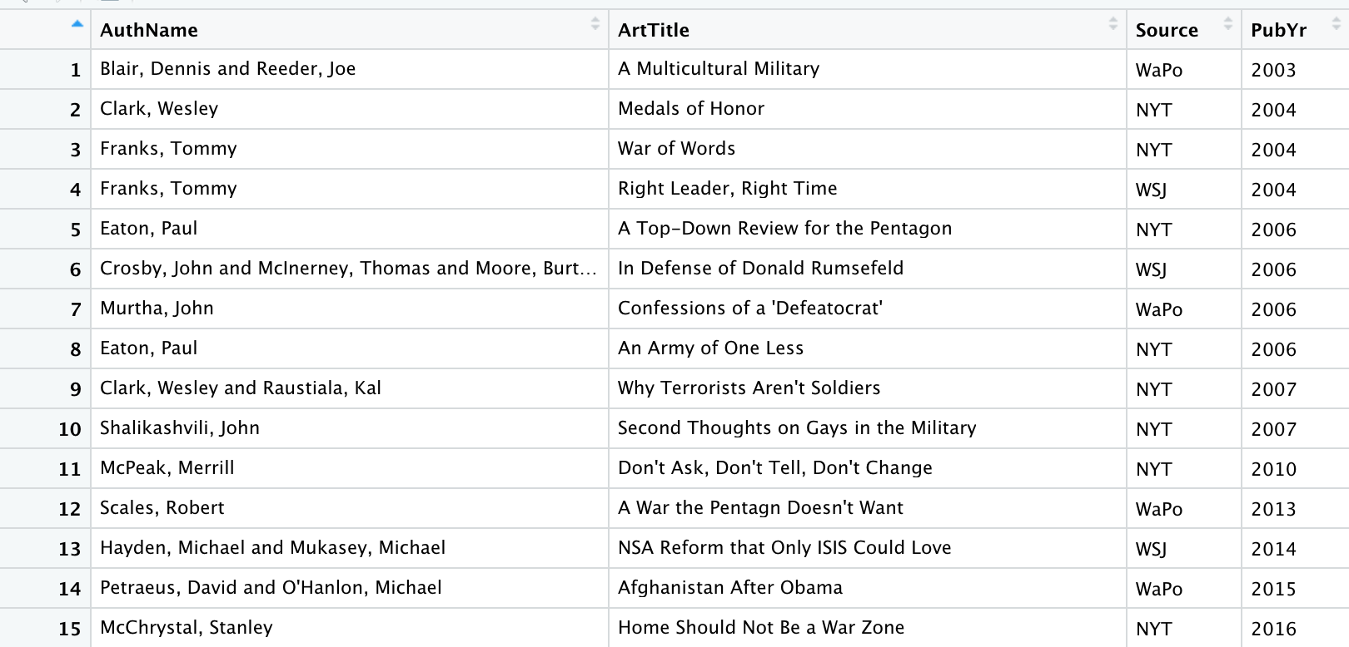
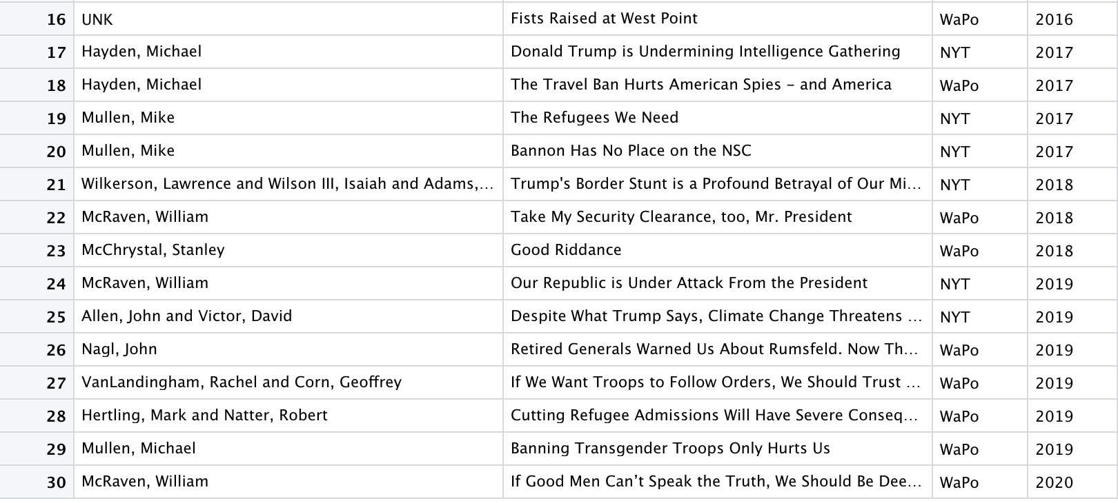
Note: I removed #s 7 and 16 from the list. John Murtha was an elected official and as such we expect him to write partisan pieces. # 16 is an unknown person who was writing a letter to an editor, not a deliberate op-ed.
Probably ok.
Questionable
Inappropriate
Topic
-U. Michigan Affirmative Action Cases
-Tacit Defense of SEN John Kerry
-Tacit Defense of George W. Bush
-Endorsement of George W. Bush
-Attack of SECDEF Donald Rumsfeld
-Defense of SECDEF Donald Rumsfeld
-Jab at Rumsfeld after midterm elections
- Approach to terrorists harms democracy
-Don’t Ask, Don’t Tell – Support/Change
-Don’t Ask, Don’t Tell – Support/Change
- Critical of Obama re: Syria
- Critical of the 113th Congress
-Recommendations for Afghanistan
-2nd Amendment Recommendations
-Trump’s Policies are Hurting Intelligence
-Trump’s Travel Ban and Spying
-Trump and Refugees
-Trump and the NSC
-Alleges use of military at border is wrong
-Sarcastic Jab at Trump
-Confederate Battle Monuments
-Alleges Trump is Destroying the Country
-Trump and Climate Change
-Warning About Trump
-Concern about Trump’s handling of cases
-Trump’s Refugee Ban
-Trump’s Transgender Troop Ban
-General Political Atmosphere

Slide 10
Key Takeaways
Over the 20 year period, we have seen retired military officers write on some controversial topics that sometimes break the traditional military norm of remaining “apolitical”
Endorsing political candidates for office – evident in Presidential Elections, especially from 2004-onward
Revolt of the Generals (2006 against Rumsfeld) and perhaps a “2nd Revolt” ongoing
What’s Different/New?
the publication of opinion pieces that comment on tangential political issues – topics that do not directly impact the military
Important topics, but should military voices be weighing in on topics such as:
2nd Amendment and Gun Control, Transgender Ban, Refugee Policy/Immigration, and Climate Change
The fervor with which retired military are attacking sitting political figures – namely, President Donald Trump and his administration.
Normative questions American society should consider include:
On what topics should Americans expect retired military officers to provide “expert advice” as a result of their professional experiences (i.e. Fighting a War versus domestic political opinions)?
How are various actors (the media, individual retired officers) leveraging the “institutional trust” of military elites to sway and influence public opinion?
To what degree do these trends make it more difficult for active military to provide their expert advice on military matters?
To what degree will these trends erode the public’s trust?

Slide 11
Next Steps
Scrub the Data….again (June 2020)
What is the true “denominator”? Have I caught all of the op-eds written by retired military in these sources?
Determine how the ”macro” changes in media and particularly, opinion pieces, influence my findings
More online avenues to publish – what does this mean?
Incorporate a textual analysis to measure tone and other items (July 2020)
Finish a full-blown paper on this subject by the end of the Summer (August 2020)
Questions

